Slide 1
POLICE STATION MANAGEMENT SYSTEM
PRESENTED BY
AKILANDESWARI S
III-BSc. Computer Science
GUIDED BY
DR P.KOKILA

Slide 2
ABSTRACT
The police management application can help in storing the records related to the cases, complaint record, complaint history and so on. This can allow a person to enter or delete the records if necessary. All these records can be maintained in a single database. Security is maintained so as to ensure that only the authorized users will have access to the system. This application will be one of the useful projects that the police can rely on. It can also help in minimizing most of the work of the police.

Slide 3
OBJECTIVE
Our software facilitates the User registration and submission of crime reports and complaints against particular individuals. Additionally, users can also check the status of their cases through the software.

Slide 4
HARDWARE SPECFICATION
Processor : P 4 700 GHz.
RAM : 4 GB RAM
Hard Disk Drive : 180 GB

Slide 5
SOFTWARE SPECIFICATION
Operating System : Windows 7/8/10
Front End : PYTHON
Back End : MYSQL

Slide 6
EXISTING SYSTEM
In the existing police station management system, most of the operations are done manually like send complaints, taking actions against crimes, view status etc. This system needs more man power to track the records of crimes. In the current system all work is done on papers so it is very difficult to secure crime reports data. Error detection in the previous entries made and data cross verification is another important function. These are done manually, and it would take time.
Disadvantages
The existing system doesn’t have system security.
The existing system is time consuming and not very user friendly.
the existing system has more workload for the authorized person, the existing system has more workload for the authorized person.

Slide 7
PROPOSED SYSTEM
The proposed crime records management system can overcome all the limitations of the existing system. The system provides proper security and reduces the manual work. The existing system has several disadvantages and many more difficulties to work well. These are done manually, and it would take time, the existing system has more workload for the authorized person, but in the case proposed System, the user can register in our site and send the crime report and complaint about a particular city or person,
Advantages
The proposed system helps the user to work user friendly and he can easily do his jobs without time lagging.
The proposed system tries to eliminate or reduce these difficulties up to some extent
Easy to manage the software

Slide 8
MODULES:
POLICE STATION REGISTRATION MODULE
CITIZEN REGISTRATION MODULE
COMPLAINT REGISTRATION
VIEW COMPLAINT
COMPLAINT HISTORY

Slide 9
Modules
Police stations registration module: This module maintains the information about all the police stations that are registered as per the jurisdiction of the system. Once the prospective station registers with the software they can avail the existing records.
Citizen Registration module
This module first should contain the collect the information by manually, they citizen themselves gave username and password using this to entered in to the login application. Once they entered into the application, they will raise the complaint.

Slide 10
Complaint Registration
Citizens are manually raising the complaint to the respective police station. Once they will raise the request a police station admin can get the notification. They can take an action to the respective complaint.
View Complaints
The admin can able to view the pending cases in this module. it has been managing by the system admin he/she can allocate the case to the respective police then they can follow the request.
Complaints history
The citizens are checking their cases history in this module, whether which is closed or not. Based on these they can view the complaint history. Police also monitoring this module can helps to find the pending cases.

Slide 11

Data Flow Diagram
Level 0

Slide 12
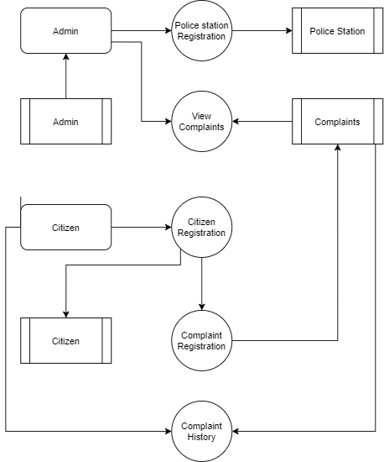
Level 1:

Slide 13
TABLE STRUCTURE
TABLE NAME: ADMIN
FIELD | DATA TYPE | SIZE | CONSTRAINT
Adminid | INT | 10 | Primary key
Username | Varchar | 20 | Not null
password | Varchar | 20 | Not null
TABLE NAME: POLICE STATION
FIELD | DATA TYPE | SIZE | CONSTRAINT
Station id | Int | 10 | Primary key
Station name | Varchar | 20 | Not null
Address 1 | Varchar | 30 | Not null
Address 2 | Varchar | 30 | Not null
City | Varchar | 15 | Not null
State | Varchar | 15 | Not null
Pincode | Int | 6 | Not null
Landline number | int | 10 | Not null

Slide 14
TABLE NAME: CITIZEN
FIELD | DATA TYPE | SIZE | CONSTRAINT
citizen id | Int | 10 | Primary key
Firstname | Varchar | 20 | Not null
Lastname | Varchar | 20 | Not null
Mobile | Int | 10 | Not null
Address 1 | Varchar | 30 | Not null
Address 2 | Varchar | 30 | Not null
Areaname | Varchar | 15 | Not null
City | Varchar | 15 | Not null
State | Varchar | 16 | Not null
Pincode | Int | 6 | Not null

Slide 15
TABLE NAME : COMPLAINT
FIELD | DATA TYPE | SIZE | CONSTRAINT
Complaint id | Int | 10 | Primary key
Citizen id | Int | 10 | Foreign key
Station id | Int | 10 | Foreign key
Complaint person | Varchar | 20 | Not null
Complaint issue | Varchar | 30 | Not null
Current address | Varchar | 30 | Not null

Slide 16
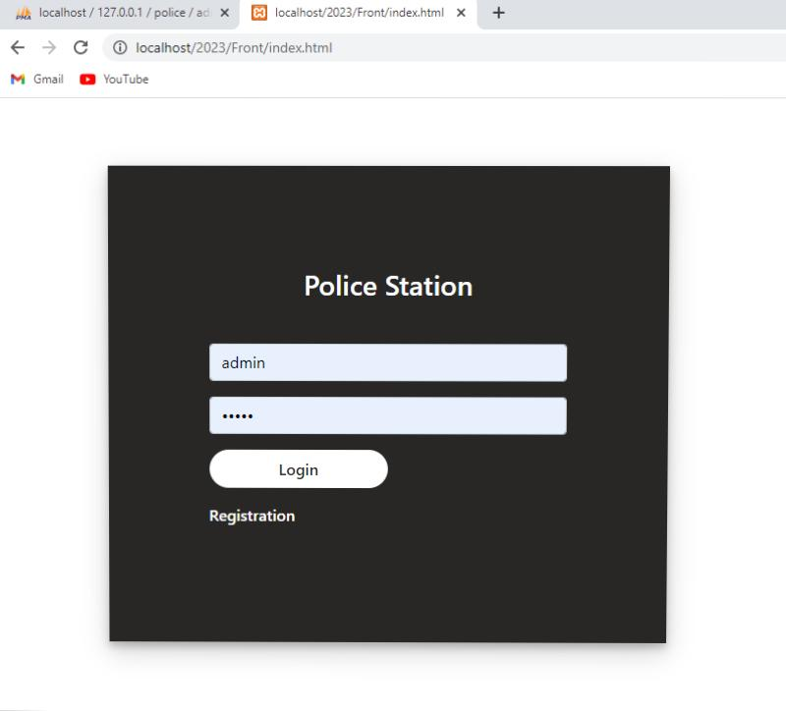
FORM DESIGN

Slide 17
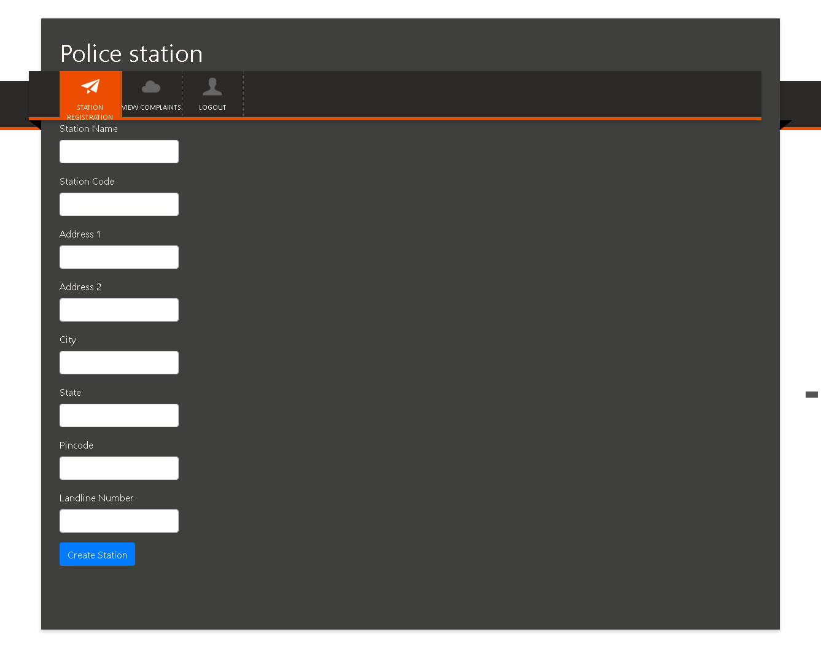

Slide 18
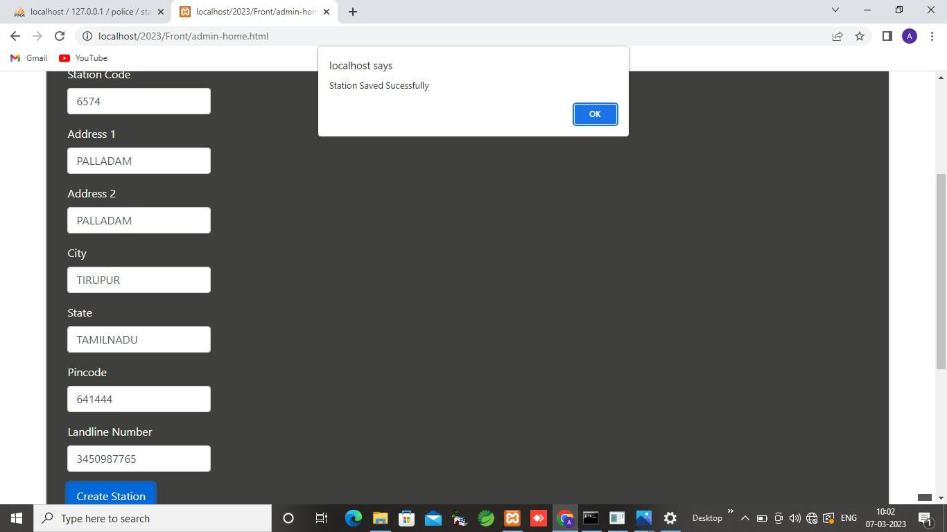

Slide 19
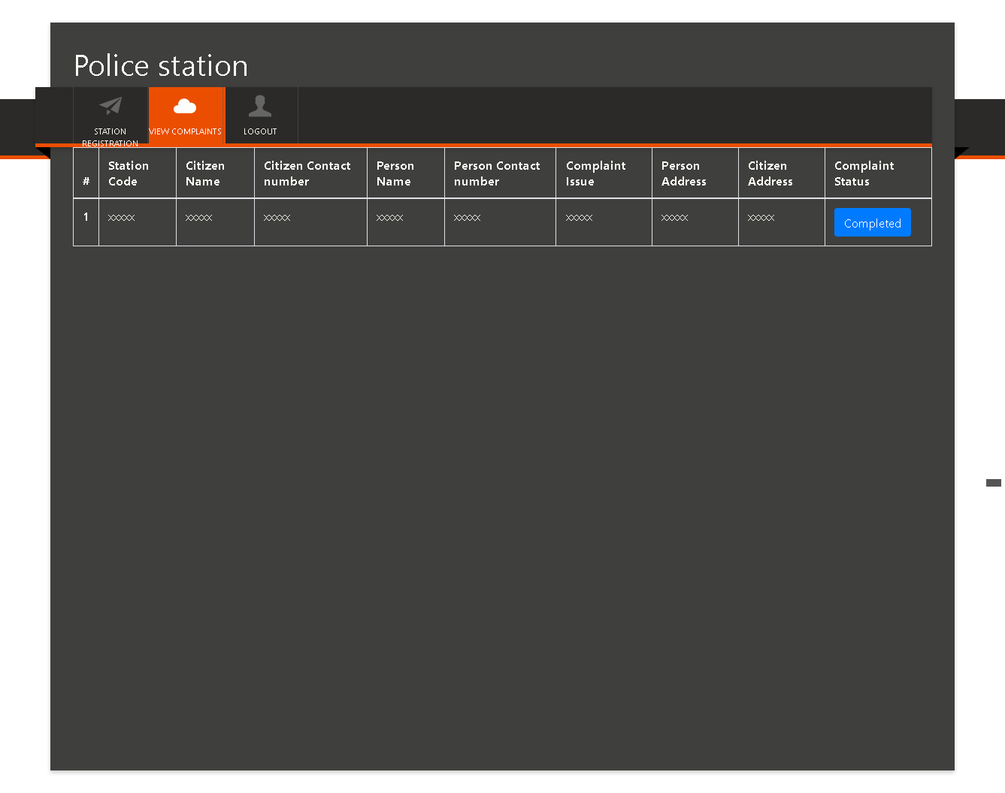

Slide 20
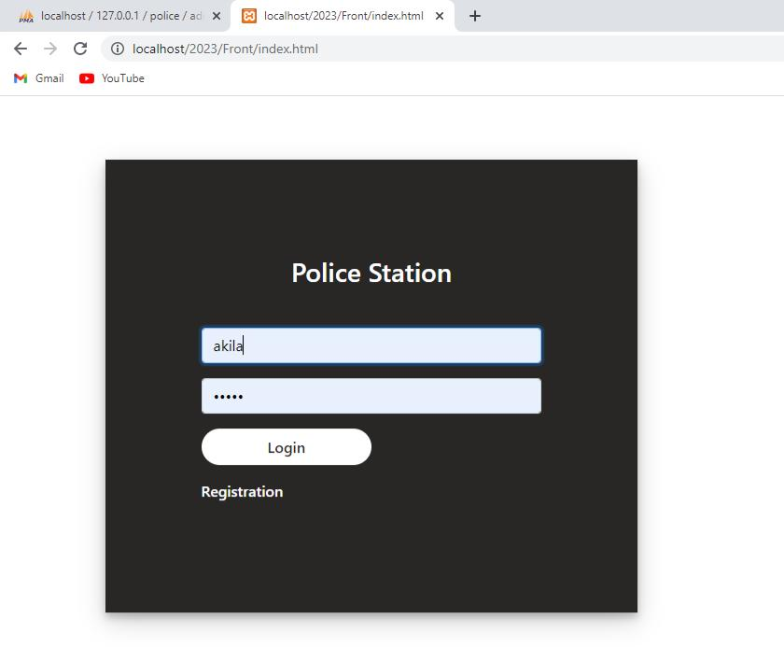

Slide 21
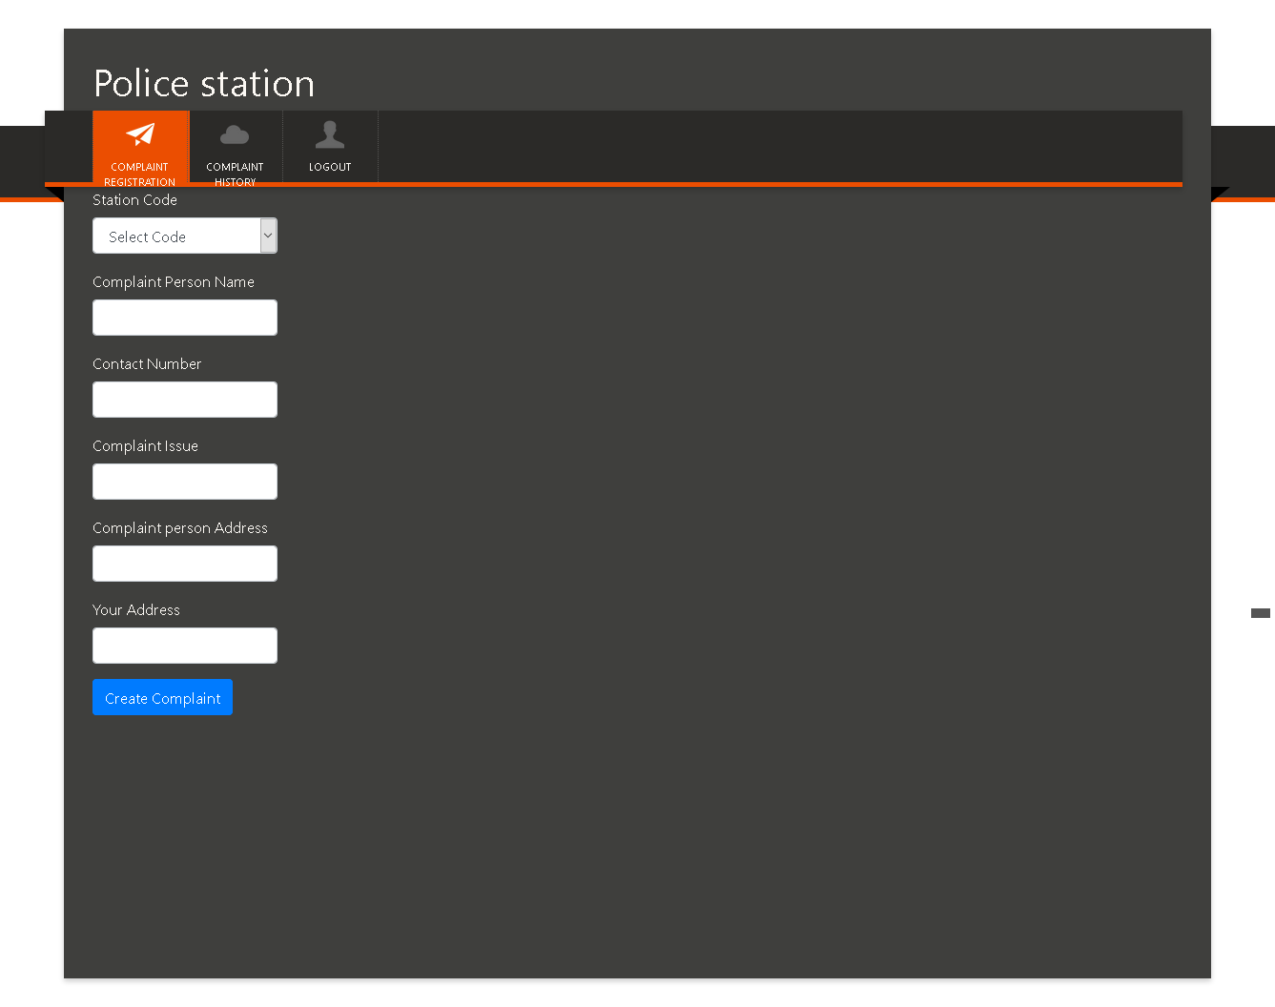

Slide 22
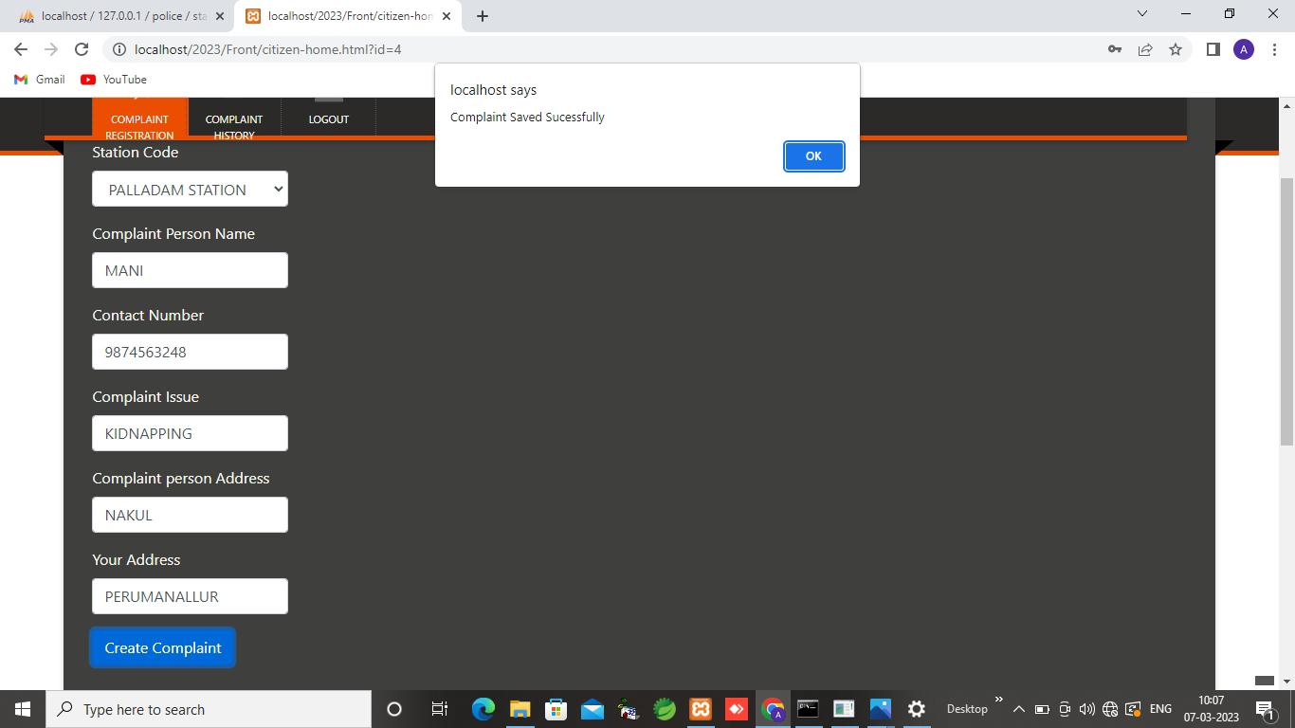

Slide 23
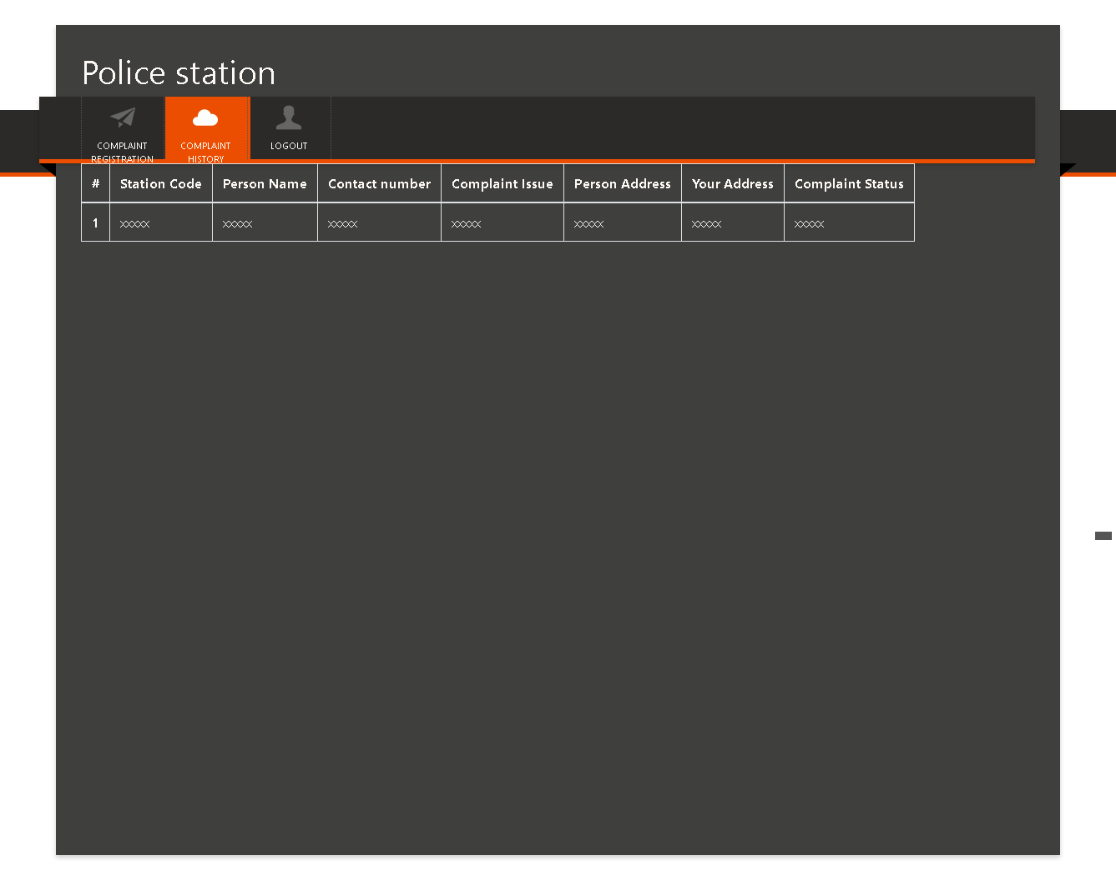

Slide 24
Thank You

